Slide 1

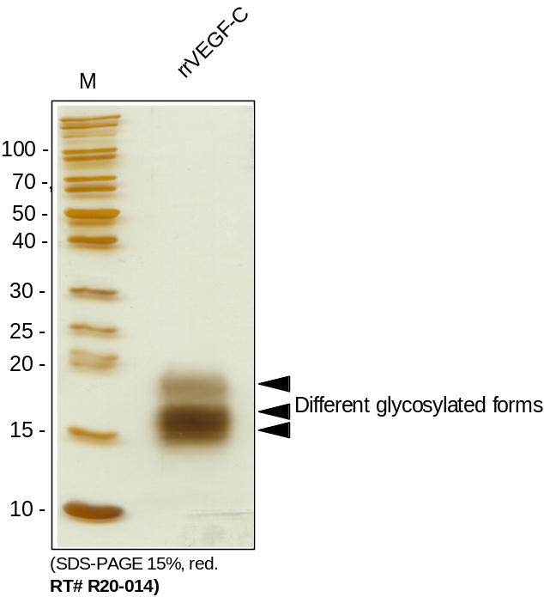
ReliaTech GmbH
Recombinant rat VEGF-C
(Cat #R20-014 / -015 )
Fig. 1: SDS-PAGE analysis of recombinant rat VEGF-C. Samples were loaded in 15% SDS-polyacrylamide gel under reducing conditions and stained with Silver stain.
http://www.reliatech.de / orders@reliatech.de

